Slide 1

Employee Data Analysis Using Excel
STUDENT NAME : MADHUSHREE.D
REGISTER NO : 312201363 & asunm110312201363
DEPARTMENT : COMMERCE
COLLEGE : DRBCCC HINDU COLLEGE

Slide 2
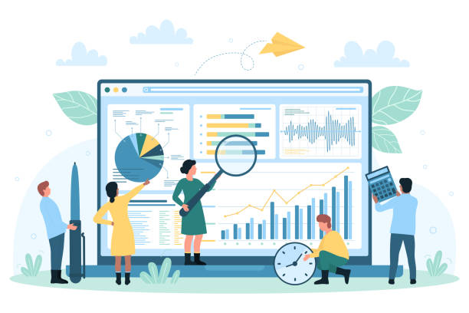
PROJECT TITLE
Employee Salary Analytics Using Excel

Slide 3

AGENDA:
1.Problem Statement
2. Project overview
3. End User
4.Our solution and Propositions
5.Dataset Description
6.Modeling Approach
7.Result and Discussion
8.conclusion

Slide 4

PROBLEM STATEMENT
The objective of this project is to analyze the distribution of employee age and salary across various work locations, with a focus on gender differences. The goal is to identify any significant disparities in salary distribution between male and female employees across different offic

Slide 5
Data Prep
Cleaning and validating the dataset to ensure accuracy (e.g., checking for missing values or incorrect entries).
Structuring the data to facilitate analysis (e.g., grouping by department, gender, or location).
It looks like you've uploaded another image. If you need help creating a PowerPoint slide with an agenda focused on explaining employee salary analytics, here's a template you can use:---### Slide Title: **Employee Salary Analytics Overview****Agenda:**1. **Introduction** - Purpose of the analysis - Overview of the data sources2. **Data Visualization** - Explanation of the chart: Sum of Age and Salary by Work Location and Gender - Key metrics and what they represent3. **Gender-Based Salary Analysis** - Breakdown of salary distribution by gender across various locations - Identification of any disparities or trends4. **Location-Specific Insights** - Detailed analysis of specific locations with significant variances - Comparison between locations with high and low salary sums5. **Age-Related Trends** - Correlation between age and salary across different locations - Insights into age demographics and salary impact6. **Conclusion** - Summary of key findings - Recommendations for further actions or policies7. **Q&A** - Open floor for questions and discussions---If you need to include specific data from the chart or the content of the images you've uploaded, feel free to describe what you'd like to include, and I can assist in crafting the content further!

Slide 6

WHO ARE END USER
1.HR (Human Resources) Team 2. Management and Executives
3..Diversity and Inclusion 4.Finance Department 5.Employee

Slide 7
OUR SOLUTION AND PROPOSITION
1.Data collection and cleaning 2. Data Segmentation and Aggregation 3.Visualization 4.Analysis and insights 5.Regulatory compliance 6.Improved Workforce Diversity

Slide 8
Dataset Description
Name: The unique identifier for each employee, capturing their full name.
Gender: The gender of the employee, used to analyze diversity and pay equity.
Age: The age of the employee, allowing for demographic and experience-based analysis.
Salary: The annual salary in INR, used to assess income levels and compensation patterns.
Department: The department where the employee works, aiding in role-based comparisons.
Work Location: The city where the employee is based, helping identify location-specific trends.

Slide 9
The employee data analysis using excel sheet in employee data analysis is used for the purpose to find the salary of the employee
THE WOW IN OUR SOLUTION:

Slide 10
MODELING AND APPROACH
1. Data Aggregation
Summed age and salary by gender for each work location.
2. Visualization:
Created a bar chart to compare sums across locations by gender.
3. UAnalysis:
Identified patterns and disparities in the data, focusing on gender-based differences.
4. Insight Generation:
Highlighted locations with potential gender inequities in salary and age distribution.

Slide 11

Summary:
TO FIND THE SALARY OF THE EMPLOYEE BY USING THE EXCEL
THE RESULTS SHOWN IN THE GRAPH

Slide 12
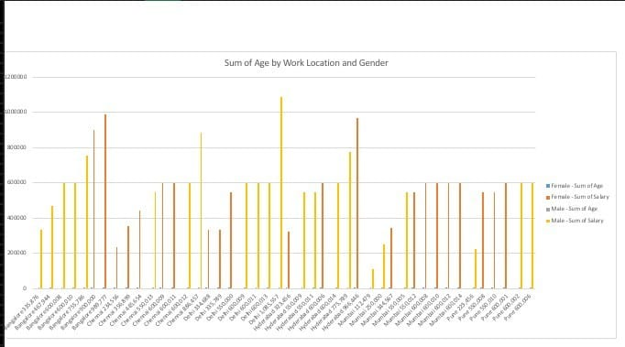
CHART

Slide 13
Recommendations
Propose actionable strategies to address any identified salary disparities.
Suggest improvements in compensation policies, such as merit-based pay adjustments, regional salary adjustments, or promoting diversity and inclusion.

Slide 14
Conclusion
Recap of the main points discussed during the analysis.
Open floor for any questions or further analysis requests.

